Slide 1
YARP
Yet Another Robot Platform

Slide 2
Summary
What is YARP?
Who uses YARP?
How to use it?
And … Why?

Slide 3
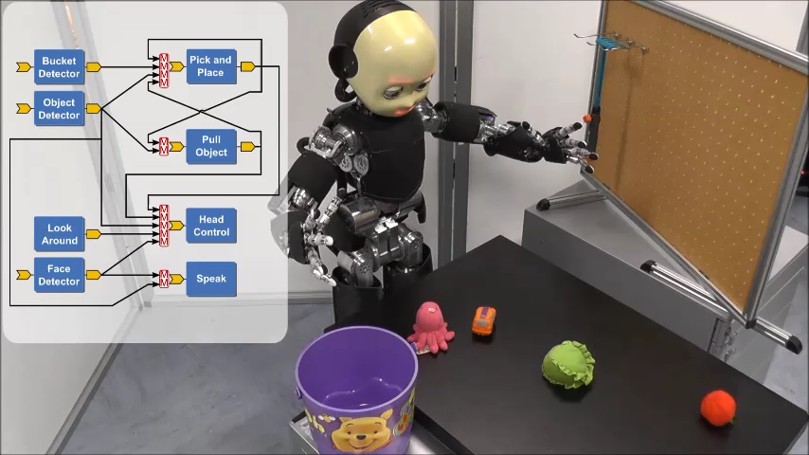
Let’s start from the end – Why?

Slide 4
Why do we need a framework?
Various scenarios and platforms
Hardware changes in time
Lots of different sensors
Lack of standards
Distributed processing
Real-time friendly
Algorithms/libraries/code changes in time
Inherent complexity
Distributed development
Short life span of projects
HARDWARE
SOFTWARE
MAINTAINCE

Slide 5
What is YARP?
“If data is the bloodstream of your robot, then YARP is the circulatory system.”
[Paul Fitzpatrick]

Slide 6
What is YARP?
“We're not out for world domination.”
[Paul Fitzpatrick]

Slide 7
What is YARP?
YARP is a middleware aimed to ease the development of high level application for robots with a strong focus on modularity, code re-usage, flexibility and hw/sw abstraction.
Homogeneous set of libraries, GUIs, tools,
debug and run facilities

Slide 8
What is YARP?
YARP is a middleware aimed to ease the development of high level application for robots with a strong focus on modularity, code re-usage, flexibility and hw/sw abstraction.
YARP has been designed to support building robot control systems as collection of executables communicating in a peer-to-peer way, with an extensible types of connections (tcp, udp, multicast, local, MPI, mjpg, XML/RPC, tcpros, ...).
The strategic goal of this kind of design is to increase the longevity of robot software projects.

Slide 9




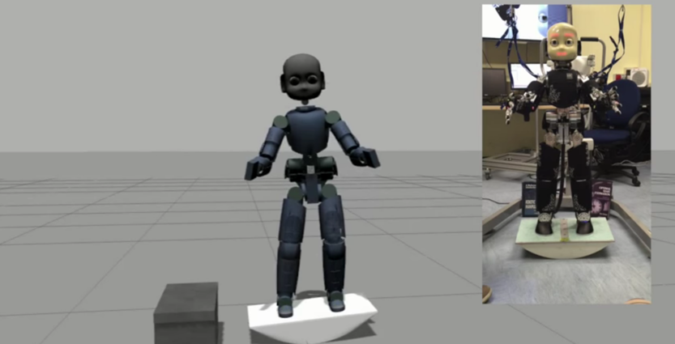
Typical application
Real robot
Simulator
: Process
: Machine

Slide 10
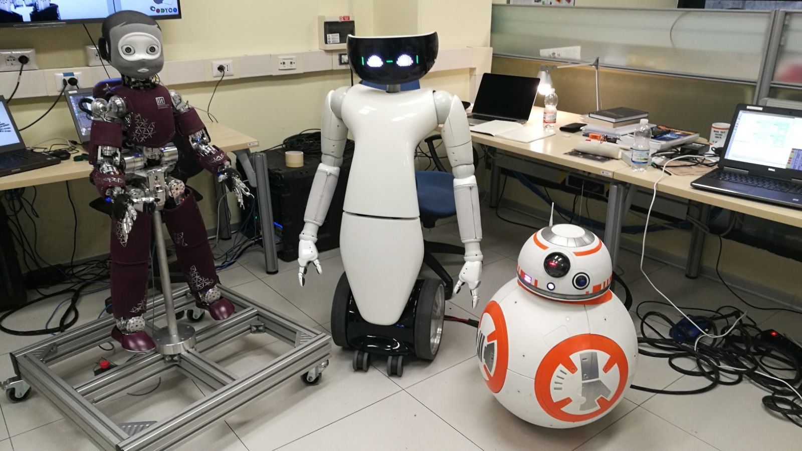
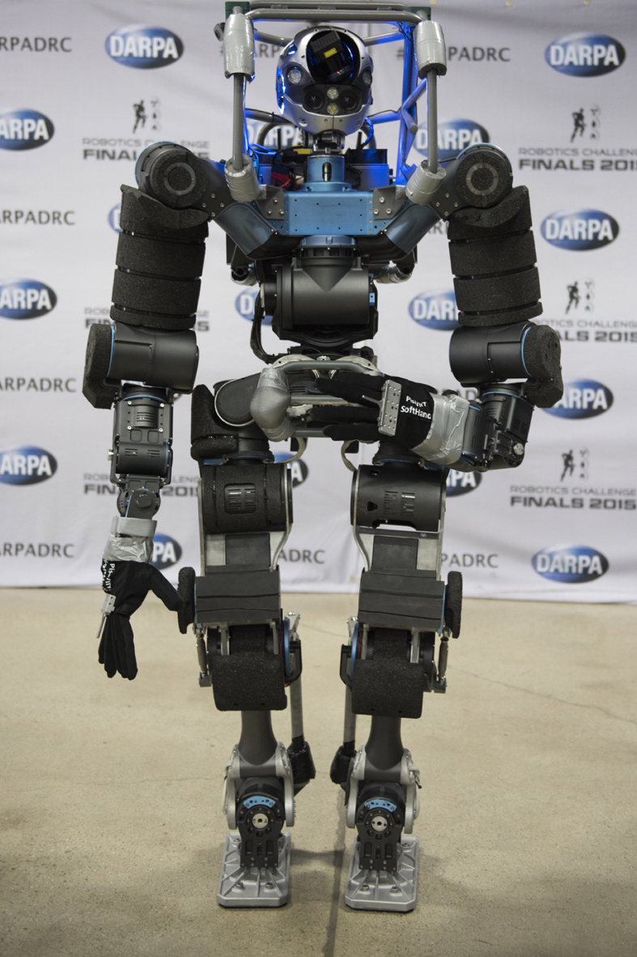
Who uses YARP

Slide 11

Ports: How YARP communicates
YARP ports are the communication entry point.
A port is a bi-directional communication entity.
Many clients can connect to a port.
Each connection can use different protocols or custom carrier to manipulate data on the fly.
YARP module
Port
Vision
algoritmhs
udp
mjpeg
Port
Image
viewer
Robot
Port
Port
tcp
Port
udp
Port
Control
module
Port

Slide 12
Ports: How YARP communicates
YARP server acts as a DNS, resolving yarp port names into system sockets
tcp
YARP module
Camera
/rpc
/command
vision
algorithms
/image:o
/vision:i
$ yarp name list
/image:o 192.168.1.1:10001
/vision:i 192.168.1.2:10002
/view:i 192.168.1.3:10003
/command 192.168.1.2:10004
/rpc 192.168.1.3:10005
udp
mjpeg
yarp server
image
viewer
/view:i
yarp connect <source> <receiver> <carrier>(tcp)
$ yarp connect /command /rpc
$ yarp connect /image:o /vision:i udp
$ yarp connect /image:o /view:i mjpeg

Slide 13
Data types
class MyData : public yarp::os::Portable
{
// Portable interface toward YARP
read(…);
write(…);
// Custom user methods for data handling
fill_me();
getData();
// Usually for readability
toString();
}
Data in YARP are Portable classes with read and write capabilities.

Slide 14
yarp::os::Value
class yarp::os::Value : public Portable
{
Value(int x); // Create an integer data.
Value(double x); // Create a floating point data.
Value(const std::string& str); // Create a string data.
Value(void *data, int len); // Create a binary data.
bool isInt32();
bool isFloat64();
bool isString();
bool isBlob();
int asInt32(); // Get integer value.
double asFloat64(); // Get floating point value.
std::string asString(); // Get string value.
char* asBlob(); // Get binary data value.
…
}
Value is a container able to store in a uniform way a single instance of different basic data types.
Data can be extracted in its native format with asXXX function.
Value can be queried to know its data type.

Slide 15
yarp::os::Property
Dictionary type of data
Property prop;
prop.clear();
prop.put(“myInt”, 5);
prop.put(“myString”, “Hello World”);
prop.put(“myPi”, 3.14);
Property &myGroup = prop.addGroup(“group1”);
group1.put(“g1”, 2.5);
group1.put(“g2”, “We have cookies”);
prop.check(“myInt”);
Value myInt = prop.find(“myInt”);
double myPi = prop.find(“myPi”).asFloat64();
Bottle &group = prop.findGroup(“myGroup”)
Works in pair <key, data>, where
Key is a string
Data is a yarp::os::Value
Entry can be grouped together, with a key
Entry and group can be searched by the key

Slide 16
yarp::os::Bottle
Most flexible type of data.
Bottle bot;
void clear();
bot.addInt32(5);
bot.addString("hello");
Bottle& b1 = addList();
b1.addFloat64(10.2);
Property &prop = bot.addDict();
prop.put(“pib”, “Help me”);
Value &v0 = bot.get(0);
Value &v1 = bot.get(1);
Can hold variable number of Value.
Bottle can be appended or nested one into another.
A Property can be an element of a Bottle
Bottle can be accessed using indexes.
Size is the number of element you can get()

Slide 17
yarp::sig::ImageOf<PixelType>
Container for image type
Template working with many different pixel types
Full documentation here: http://www.yarp.it/classyarp_1_1sig_1_1ImageOf.html
ImageOf<PixelRgb> yarpImage;
yarpImage.resize(300,200);
PixelRgb rgb;
rgb = yarpImage.pixel(10, 20);

Slide 18
Working with Ports – Client/Server
Ports are identified by their name.
Constraints:
Names must be unique
Names must start with ‘/’ character
No ‘@’ character allowed
Ideal for client/server pattern
yarp::os::Port myPort;
myPort.open(“/port”);
Bottle b;
port.read(b);
int n = b.get(0).asInt32();
n++;
b.clear();
b.addInt32(n);
myPort.write(b);
myPort.close();

Slide 19
Working with Ports -- Streaming
In case of continuously broadcasted data (e.g. video streaming), a yarp::os::BufferedPort<T> can be used.
Main differences:
Data type is fixed for port lifetime
Memory creation/destruction is handled by the port
Buffering policy can be set (default latest message is kept)
A dedicated thread handles the read/write operations optimizing user thread cycle
BufferedPort<Bottle> port;
port.open("/out");
// Get memory to write into.
Bottle& b = port.prepare();
b.clear();
b.addString(“Hello world”);
port.write();

Slide 20
Hardware abstraction
Client & Server on the same machine
R1
motor controller
YARP ports
Interface
Server Network Wrapper
Client Network
Wrapper
Interface
user application
iCub
motor controller
Simulator
motor controller

Slide 21
Hardware abstraction
Client & Server on the same machine
R1
motor controller
Interface
user application
iCub
motor controller
Simulator
motor controller

Slide 22
Interfaces
A class with pure virtual methods.
Servers provide functionalities by implementing required methods.
Clients use the functionalities by calling provided methods.
IPositionControl::getAxes() = 0;
IPositionControl::positionMove(…) = 0;
IPositionControl::relativeMove(…) = 0;
IPositionControl::checkMotionDone(…) = 0;
IPositionControl::setRefSpeed(…) = 0;
IPositionControl::setRefAcceleration(…) = 0;
IPositionControl::getRefSpeed(…) = 0;
IPositionControl::getRefAcceleration(…) = 0;
IPositionControl::getTargetPosition(…) = 0;
IPositionControl::stop(…) = 0;

Slide 23
Opening a device
Devices are opened by mean of a special class called “PolyDriver”.
PolyDriver is a polymorphic class which can turn into any device.
Keyword “device” tell YARP which device we really want to open.
All other parameters will be propagated to the specified device.
PolyDriver mystica;
Property config;
config.put(“device”, “device_type”);
config.put(“deviceParam1”, paramValue1);
config.put(“deviceParam2”, paramValue2);
...
mystica.open(config);

Slide 24
Remote Control Board
Device devoted to provide remote access to the robot motor control is the “remote_controlboard”
Required parameter to configure it are:
- Remote port prefix: remote
- Local port name: local
PolyDriver poly;
Property config;
config.put(“device”, “remote_controlboard”);
config.put(“remote”, “/icub/head”);
config.put(“local”, “/<myApplication>”);
...
poly.open(config);
CONTINUE

Slide 25
Remote Control Board
Once opened, we need to specify which interface we want to work with.
To get a specific view of the device:
create a pointer to the interface we want to use
fill it by calling the .view(…) function
In case the device does not implement that interface, the pointer will be NULL!
A device can implement more than one interface.
IPositionControl2 *posControl = NULL;
poly.view(posControl);
if(!posControl) // handle error
...
posControl->getAxes(…);
posControl->positionMove(…);
IVelocityControl2 *velControl = NULL;
poly.view(velControl);
velControl->velocityMove(…);

Slide 26
IPositionControl
Give access to main position control commands.
Used to send high level targets, with a velocity & acceleration profile.
For getters, memory must be allocated by user.
Units in YARP are SI compliant, except angles for controlboard, which are in degrees, degrees/s

Slide 27
IPositionControl
int joints;
posControl->getAxes(&joints); // Get number of joints
posControl->setRefSpeed(0, 5); // set a speed of 5 degrees/s for joint 0
posControl->positionMove(0, 30); // move the joint 0 to +30 degrees
bool done = false;
do
{
checkMotionDone(&done); // this function checks the movement completion
}
while(!done);
posControl->positionMove(0, 0); // reset joint position to 0

Slide 28
Other YARP features
Resource finder
Threads, Modules
Plugin loader
Carriers: mjpeg, h264, portmonitor, shared memory, depth Image, ROS
yarpView, yarpScope, Logger, MotorGui
YarpManager, YarpViz
Thrift
robotInterface

Slide 29
Other middleware
Cool!
“But I think ROS is better”

Slide 30


Ports can be typed or not
Multi-platform (also mobile)
Run-time reconfiguration of connections
Different carriers, user custom
QoS, channel prioritization
Smaller community
Rich set of libraries ad tools
Packages for all supported distributions
Both topic and service are strongly typed
Ubuntu only (ROS2 Win & Mac)
Connections from a topic use the same protocol
No concept of carrier (DDS on ROS2)
QoS on ROS2
Huge and very active community
Much more rich set of libraries and tools
Packet management

Slide 31
YARP - ROS carrier
YARP ask roscore to establish a new connection
YARP loads a specific carrier to convert data into ROS-like type on the fly
No need to have ROS installed
YARP module
yarp
node
/port
/topic
ROS
node
yarp server
roscore
/topic@/yarpNode

Slide 32
THANKS FOR THE ATTENTION!

